Slide 1
Simulating the Propagation of
Nutrient Dynamics: A Coupled
Simulation of Wastewater
Nitrification, Nutrient Recovery, and
Hydroponic Plant Growth
Group 31: Jiasheng Cao, Ruixin Liu, Zijun Meng, Yuming Sun

Slide 2
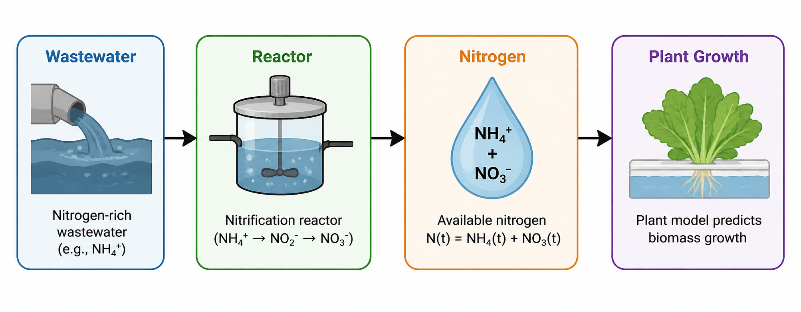
Intro & Motivation
Background:
Wastewater treatment removes nitrogen to meet standards
This leads to loss of valuable nutrients
Nitrogen is essential for plant growth
Motivation:
Can wastewater be reused as a nutrient source?
Can we link treatment with agriculture?
Our idea:
Build a coupled system:
Reactor → transforms nitrogen
Plant model → predicts biomass

Slide 3
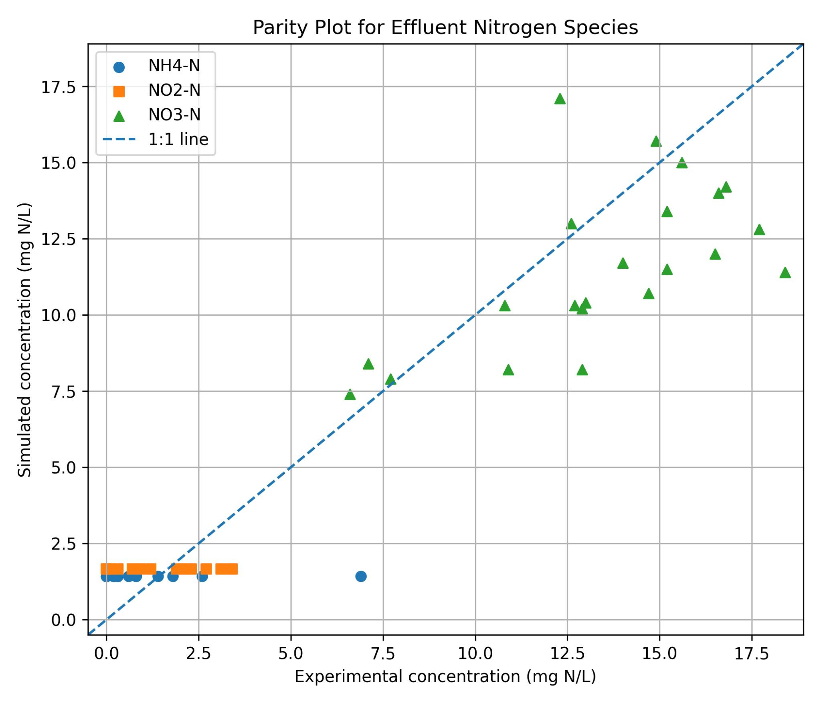
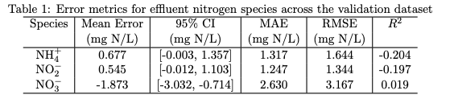




Upstream Nitrification Model Validation & Key Findings
Model Framework
Mechanistic CSTR-based nitrification model
Monod kinetics for AOB and NOB
Key Improvement
Dynamic DO mass balance included
Links engineering control with biology
Model Validation and Key Findings
22 experimental cases used
Compared NH₄⁺, NO₂⁻, NO₃⁻ at steady state (day 100)
Captures overall nitrification trend
Good agreement for nitrate
NH₄⁺ and NO₂⁻ clustered → low sensitivity
Negative R² indicates poor variability capture

Slide 4
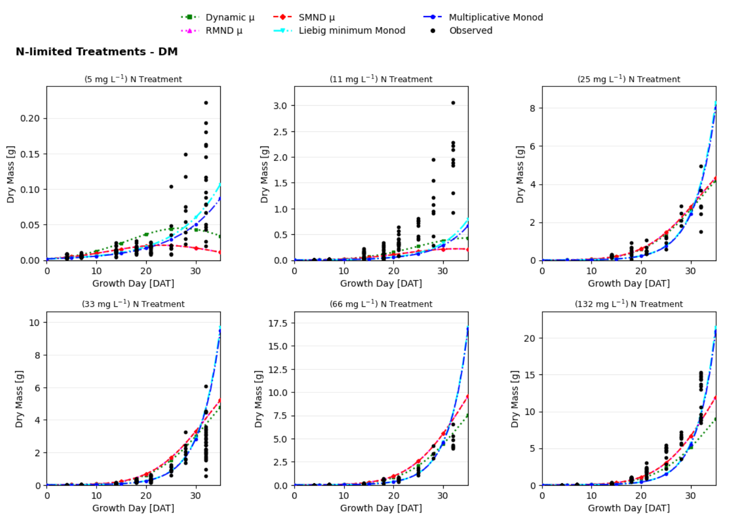
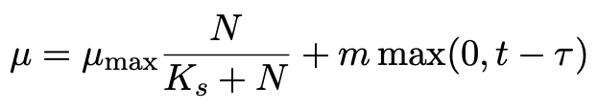
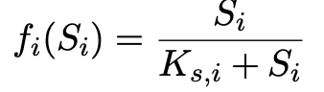
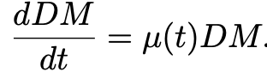
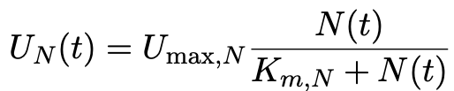
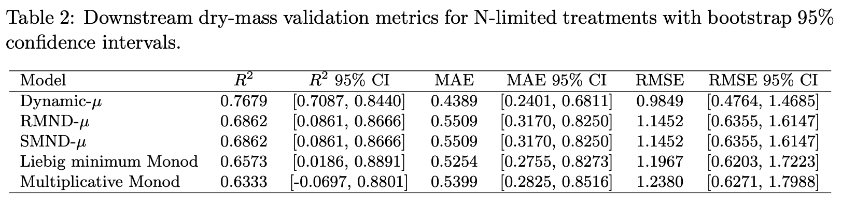
Downstream Plant Growth and Nitrogen Uptake Module
Model Framework
Input: supplied plant-available nitrogen forcing
ODE-based simulation framework, numerical integration: RK4
Specific growth rate:
5 plant-growth formulations tested
Dynamic-μ,
RMND-μ, SMND-μ
Liebig minimum Monod,
Multiplicative Monod
Dry mass:
Nitrogen uptake:
Michaelis–Menten relationship
Model Validation and Key Findings
Dynamic-μ gave the best aggregate downstream validation performance.
The calibrated plant-growth parameters
integrated framework
reusable parameter sets
Monod-type models captured general growth trends, but weaker performance. Useful when only input nutrient concentrations are available.
Simulated uptake slightly higher than observed averages but in the same order of magnitude.
Notes:
The downstream mechanistic simulation of hydroponic plant systems focused on plant-growth biomass and nutrient uptake dynamics. The model follows an ODE framework driven by nutrient signal forcing and growth-model parameters, using RK4 as time-resolved numerical integration method. The module predicts specific growth rate, dry-mass accumulation, and nitrogen uptake. Five growth formulations were tested, including 3 Dynamic-based and 2 Monod-based models. Figure shows the simulated trajectories capture dry-mass growth patterns under various nitrogen-limited treatments. Table 2 summarizes the validation metrics, where Dynamic-μ gave the best aggregate performance. The data calibrated plant-growth parameters were then used in the integrated framework. Nitrogen uptake was estimated using Michaelis–Menten relationship and prediction remained in the same order of magnitude as the observed uptake averages.

Slide 5
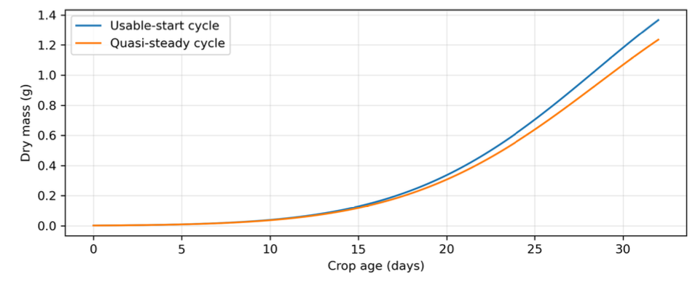

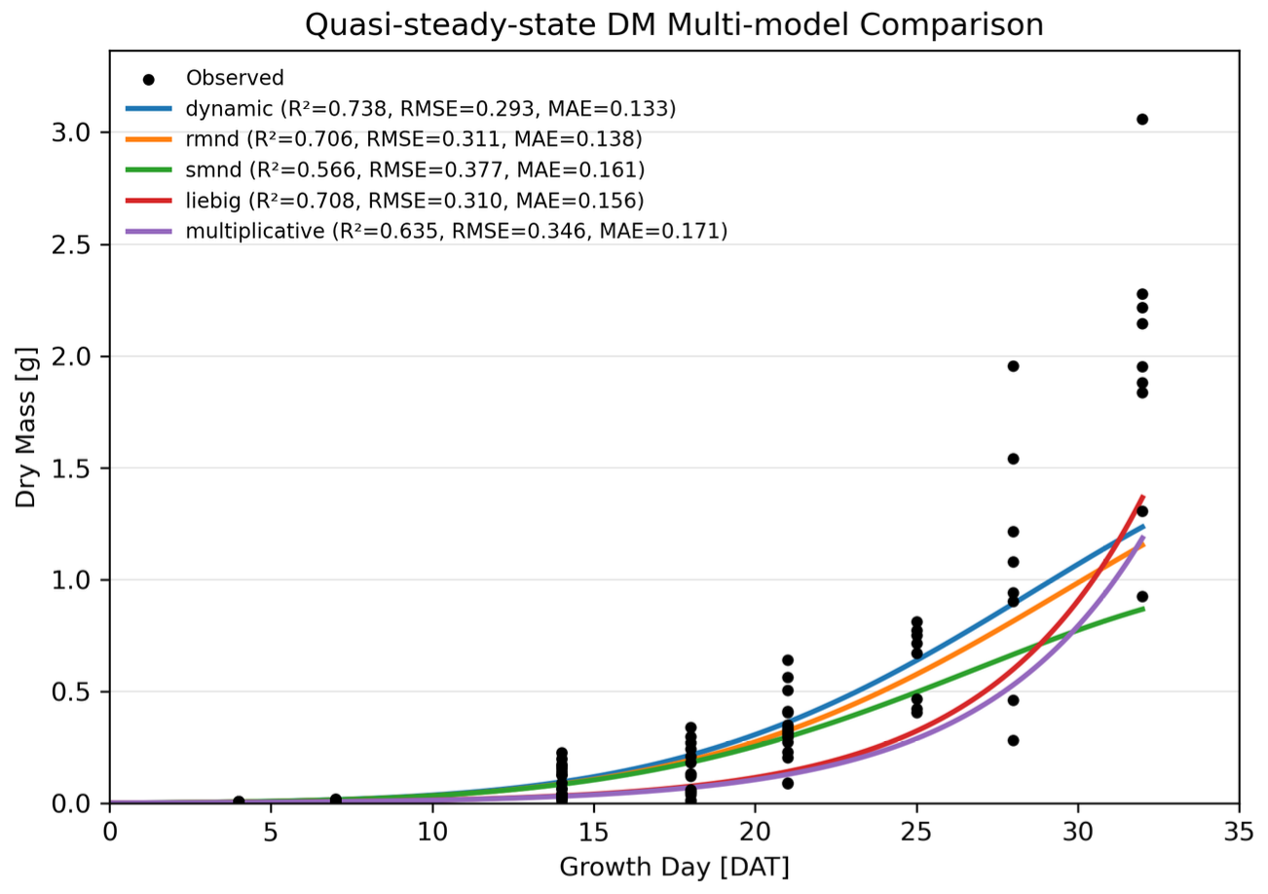
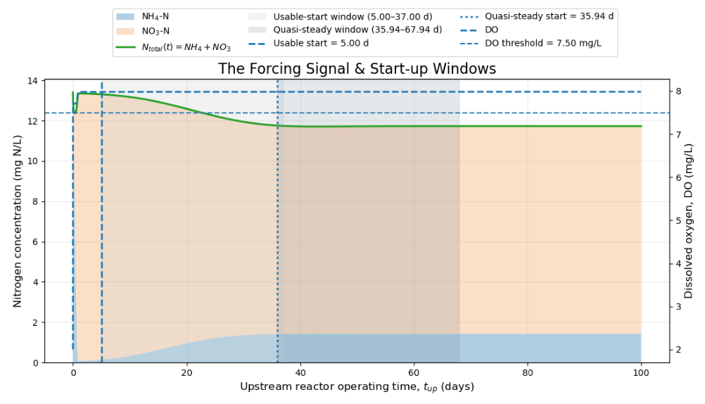
Integrated Upstream–Downstream Simulation and Validation
Module coupling Framework
expressed on nitrogen-mass basis
Reactor output mapped to lettuce crop cycle
Time windows: sable-start vs quasi-stead-state start
Mean N level matched to calibrated lettuce treatment
Integrated Module: validated using matched wastewater effluent N concentrations and plant-level dry-mass observation.
Takeaway: The coupled framework connects wastewater-derived nitrogen supply to lettuce biomass response under dynamic nutrient conditions.
Notes:
The integrated module shows how dynamic upstream nitrogen output conditions used as downstream nutrient forcing signal and propagate into lettuce biomass response.Two coupling time windows were compared shown in the left plot: an early usable-start window, representing the early dynamic trend of the reactor effluent, and a later quasi-steady-state start window with stable condition. The right plots show the predicted dry-mass trajectories, validation against observed data, and simulation performance metrics. This coupled framework evaluates how upstream reactor behavior affects downstream plant growth.

Slide 6
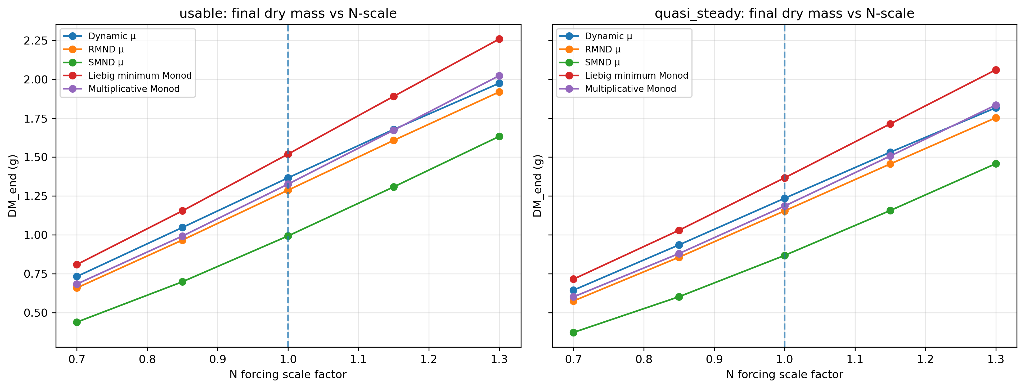
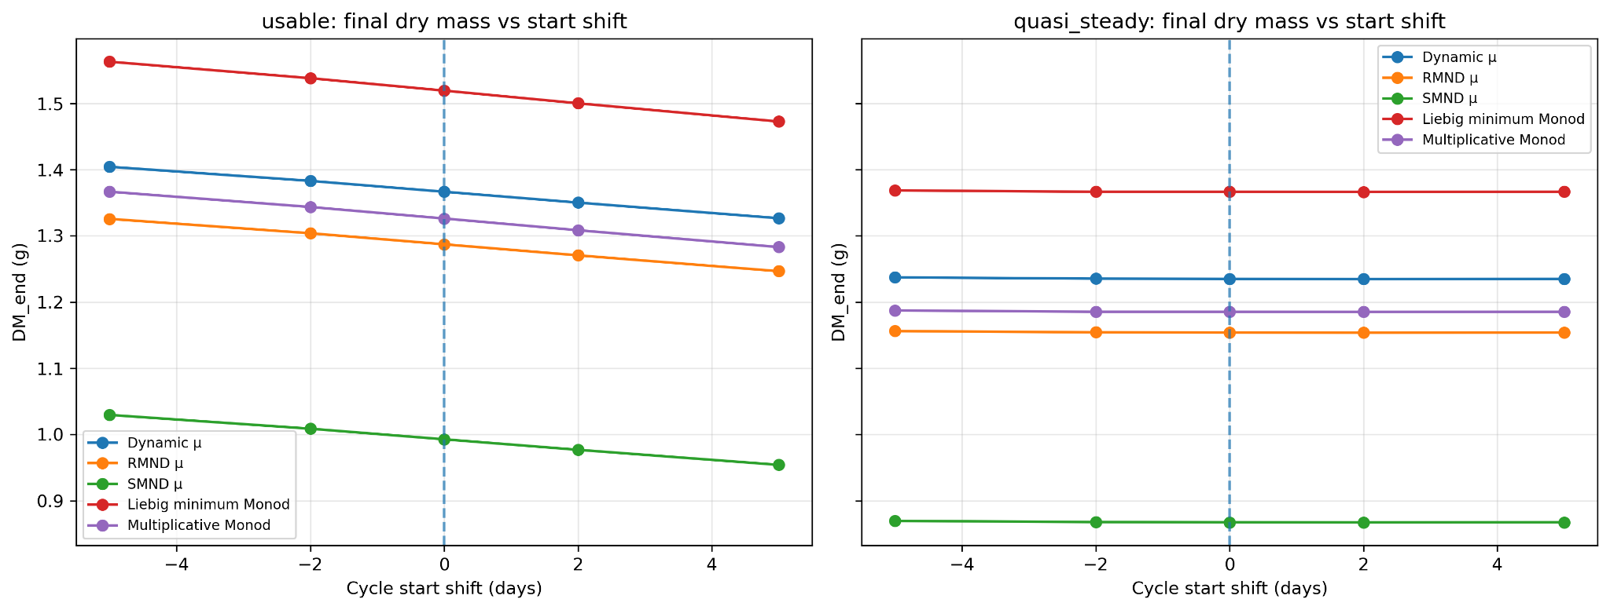
Sensitivity Analysis
Perturbations tested: Nitrogen scale: 0.70, 0.85, 1.00, 1.15, 1.30; Start-time shift: −5, −2, 0, +2, +5 days
Final dry mass increases consistently as nitrogen forcing increases.
This trend appears in both usable-start and quasi-steady-start cycles.
Start-time shifts have a much weaker effect than nitrogen scaling.
The usable-start cycle shows a small decrease when shifted later because it overlaps with transient reactor dynamics.

Slide 7
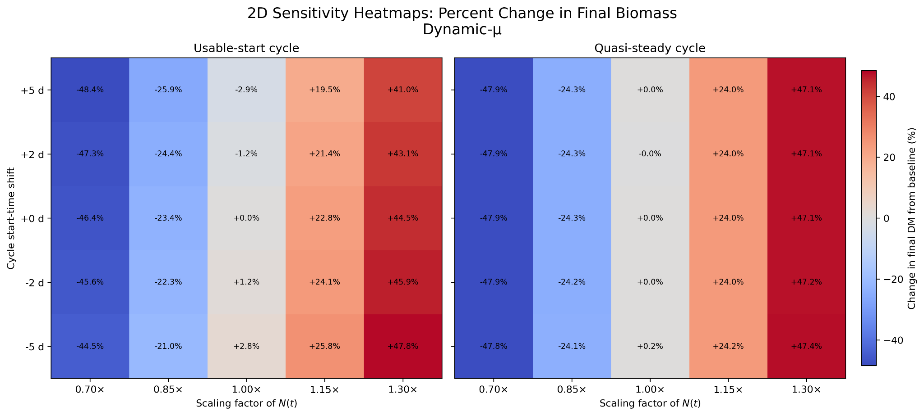
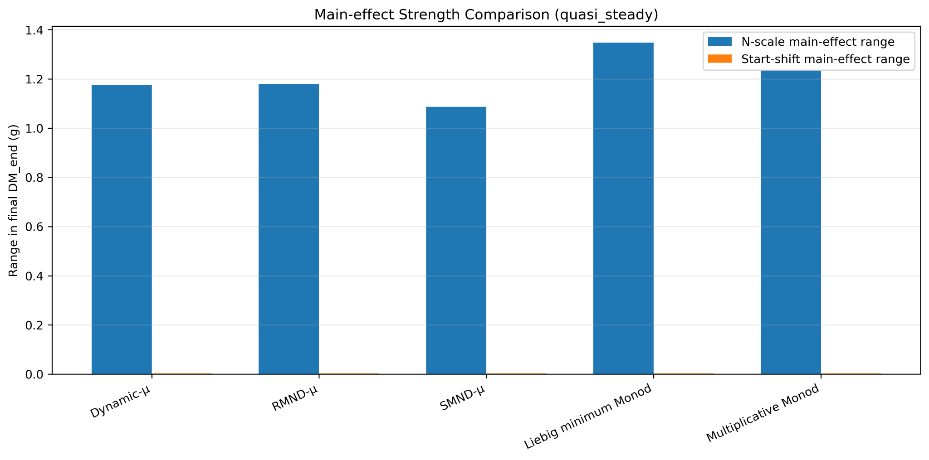
Sensitivity Analysis
The 2D heatmaps show a strong response along the nitrogen-scale direction, but only weak variation along the start-shift direction.
The main-effect comparison confirms that nitrogen scaling causes a much larger change in final dry mass than start timing.
Key takeaway: the integrated system is mainly resource-driven, not timing-driven.

Slide 8
Conclusion
Built a coupled framework linking wastewater nitrification with hydroponic plant growth
The wastewater module captured the main nitrogen transformation trend, but validation showed systematic bias: ammonium and nitrite were overestimated, while nitrate was underestimated
The plant growth module showed that biomass prediction depends strongly on the selected growth model
In the integrated system, nitrogen availability is the main driver of final biomass
Sensitivity analysis shows the system is resource-driven, not timing-driven
Future work should improve variability capture, parameter calibration, and nutrient feedback between plant uptake and reactor output

